Slide 1
Learning Objective
To understand the differences between college application deadlines
Agenda
Application Deadlines Explained

Slide 2
Announcements
Theme Fridays we will have a new theme that you can dress up either onsite or online and take a pic. Send all pics to Areal Fischer (958601@student.bisdtx.org) and Mr. Gordon (jgordon@bisdtx.org).
We will post the pictures the following week
Here are the Themes for the Fridays of November!
Nov. 6th- College Day!
Nov. 13th Class Color Day!
9th Grade Blue
10th Grade Purple
11th Grade Green
12th Grade Black
Nov. 20th -Twin Day
Nov 19th Last Day to Withdraw
Yearbook Cover Contest

Slide 3
Announcements
StuCo Meeting Tuesday, Nov. 10th at 5:30 PM

Slide 4
Application Deadlines Explained
There are four main application deadlines.
Most universities only use 1 or 2.
Early Action and Regular Decision are the two most common.
Early Action (also called Priority Decision)
Regular Decision
Early Decision
Rolling Admission

Slide 5
Application Deadlines Explained
Early Action or Priority Decision Deadline- if you turn in your application by this date, you receive an admission decision early. Sometimes the application fee is waived.
2. Regular Decision Deadline- last day to apply.
Both of these are non-binding, meaning if you get accepted you are not obligated to attend there.
(See example on following slide)

Slide 6
Application Deadlines Explained
Example:
UT at Austin’s priority decision deadline is Nov. 1st.
If you apply by this date, you will receive your admission decision by Feb. 1st.
UT’s regular decision deadline is Dec. 1st.
If you wait until this date, you will not receive an admission decision until March 1st.

Slide 7
Application Deadlines Explained
Applying early is helpful for a few reasons:
One less month of waiting to hear back.
Sometimes application fee is waived.
Many other university deadlines are March 1st, so hearing back allows you to decide if you need to apply to other universities. (I recommend applying to 3-5 universities.)

Slide 8
Application Deadlines Explained
3. Early Decision Deadline- if you apply by this date and are accepted, you are obligated to attend. This is a binding agreement. Early Decision should only be used if this is your first-choice university.
Applying Early Decision can possibly increase your chances of getting accepted.
There are only a few universities in Texas (all private) who use this including Baylor, Southwestern, Trinity, and University of Dallas.

Slide 9
Application Deadlines Explained
4. Rolling Admission- universities review applications as they are submitted and accept/ deny students throughout the admission cycle.
This is a non-binding admission decision.

Slide 10
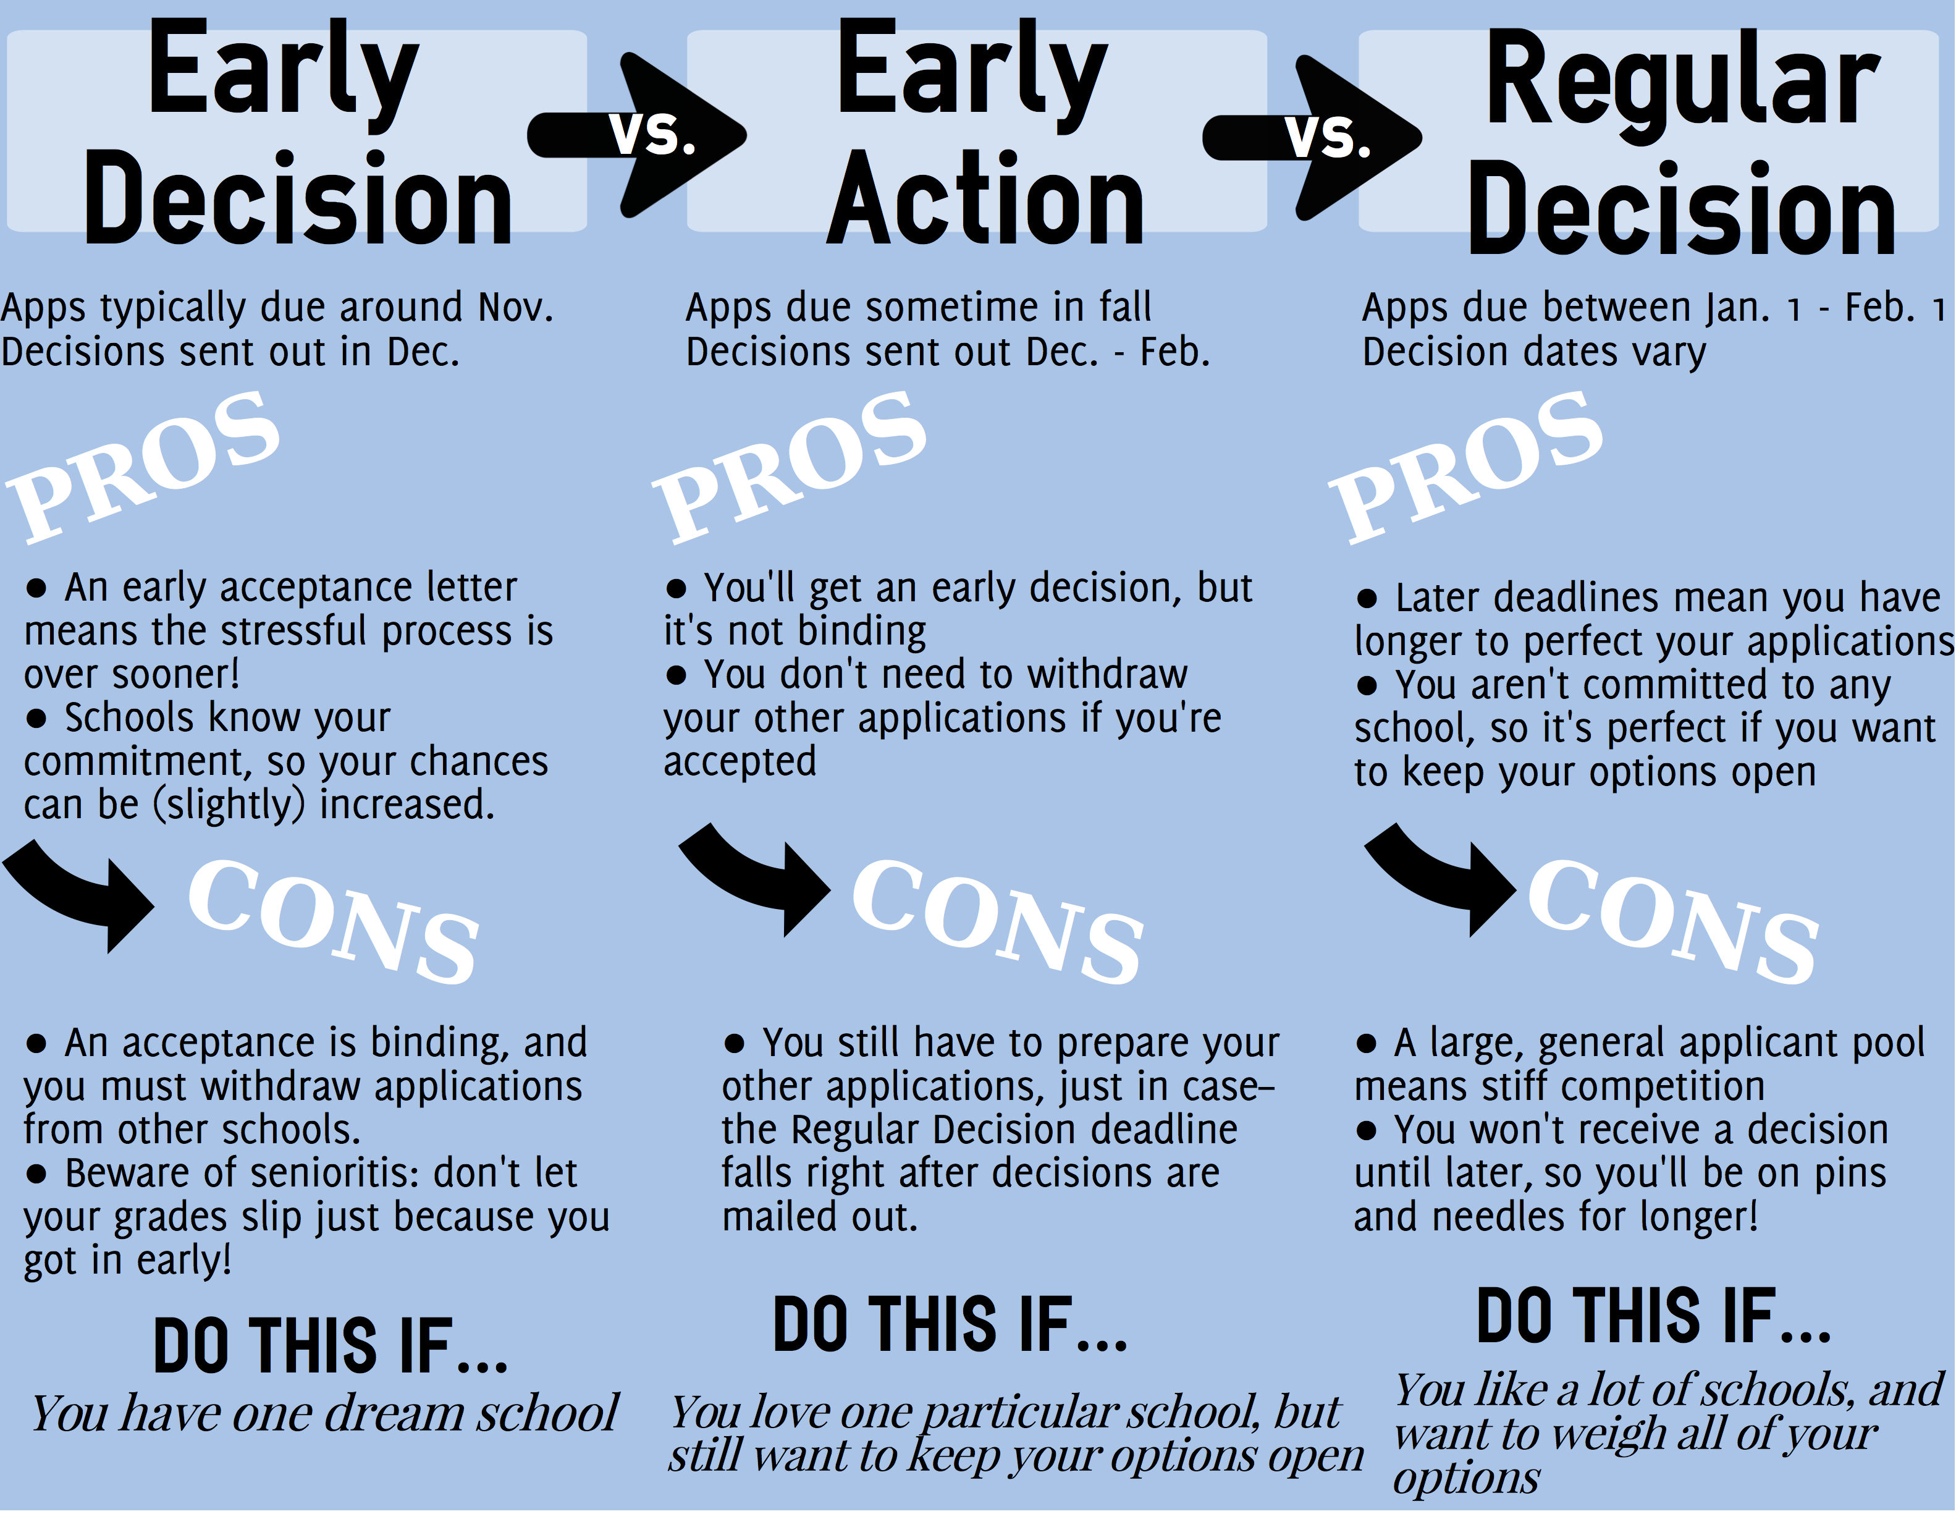
Application Deadlines Explained
Below is an infographic of the Pros and Cons of each decision.
https://theenrichery.com/2016/08/10/early-decision-early-action/

